Slide 1
String class
Prof. Irysh Paulo R. Tipay, MSCS

Slide 2
Quote For the Day
“Any fool can write code that a computer can understand. Good programmers write code that humans can understand. ” - Martin Fowler

Slide 3
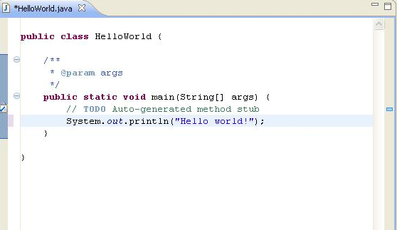
Introduction
What is a Class?
So far you know that….
building blocks in Java
contains main method

Slide 4
Introduction
Large applications in Java Contain a collection of classes.
Two types
Built-in classes - predefined functionality (System, String, Scanner)
User Defined - Created by programmer

Slide 5
Introduction
Collection of classes is called a package.
Collection of packages is called a library.

Slide 6
Introduction
As a programmer, you can create your own package or library.
You can also use libraries or packages created by other programmers.
User-defined Libraries/Package

Slide 7
Introduction
You can also use Built-in libraries/packages in Java.
java.util
java.io
java.awt
java.lang

Slide 8
Introduction
Java.lang Library
-doesn't need to be explicitly imported, java does it automatically
-included in all java programs
-provides access to the basic Java Classes
-contains String, System, Math.

Slide 9
String Class
Contains a sequence of characters
Enclosed in double quotes.
String is NOT a primitive data type
String is a class

Slide 10
Reference Variables
Variables created using the String Class are called objects
Objects in Java are reference variables.
Reference variables do not store the actual value but rather it holds the address where the value is stored

Slide 11
Reference Variables Vs Primitive Variables
Primitive Variables
var
int var = 1;
1
letter
char letter = ‘b’;
‘b’

Slide 12
Reference Variables Vs Primitive Variables
Reference Variables
str
1000111
String str = “Hello”;
1000111
“Hello”

Slide 13
String is Immutable
Objects of the String Class are “immutable”.
str
String str = “Hello”;
“10111”
str = “Hi”;
“1000111”
10111
1000111
Garbage Collection
“Hi”
“Hello”

Slide 14
Declaring Strings
String str1 = “Hello”;
OR
String str1= new String(“Hello”);

Slide 15
Declaring Strings (1)
str1
str2
String str1 = “Hello”;
String str2= “Hello”;
1100111
1100111
1100111
“Hello”

Slide 16
Declaring Strings (2)
String str1 = new String(“Hello”);
String str2= new String(“Hello”);
str1
str2
1100001
11100111
1100001
11100111
“Hello”
“Hello”

Slide 17
Comparing Strings (1)
str1
str2
String str1 = “Hello”;
String str2= “Hello”;
1100111
1100111
str1 == str2?
1100111
TRUE
“Hello”

Slide 18
Comparing Strings (2)
String str1 = new String(“Hello”);
String str2= new String(“Hello”);
str1
str2
1100001
11100111
str1 == str2?
FALSE
1100001
11100111
“Hello”
“Hello”

Slide 19
Comparing Strings (3)
String str1 = new String(“Hello”);
String str2= new String(“Hello”);
str1
str2
1100001
11100111
str1.equals(str2)?
TRUE
1100001
11100111
“Hello”
“Hello”

Slide 20
Questions?

